Slide 1
prototype
Java Implementation
of a Smart Home
Management System
Kevin Garcia | Kierstin Matsuda | Eric Cao

Slide 2
Background & Motivation
This project builds on the code from projects 1 and 2 from this class. The motivation was to make the project a prototype for a complete smart home management system. We want a real person to be able to have this as their smart home.
Problem
The previous smart home design is very hard-coded. How can we give the user control of their house and let it grow with them.

Slide 3
Prototype User Interface

Slide 4
Add and Remove and Query Devices and Sensors

Slide 5
System Challenges
Current System
Moving from a command-line interface to a GUI, user interaction with the system needed to be completely rethought and rebuilt
A command-line user can still be connected to the smart home and can control it at the same time as the user using the GUI
Reading and writing to excel files, creating new spreadsheets
Dynamically make new sensors and devices
New database system is more user friendly as it is excel-based
Users can add and remove new sensors and devices from their smart home

Slide 6
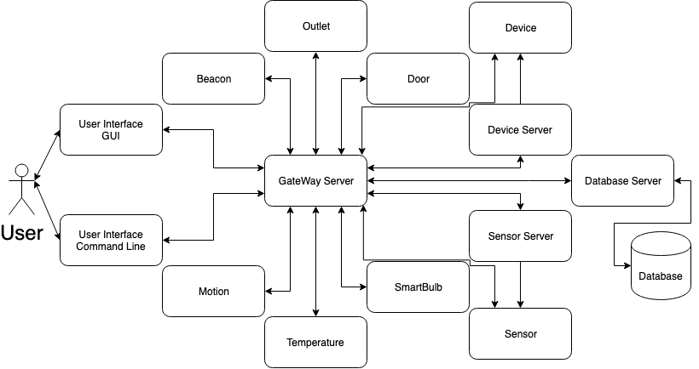
System Design

Slide 7
Evaluation
A. Passed 54 Test Cases
B. Tested User Interface on 18 people – all found it intuitive to use and could add, remove, and query devices.
C. New database design is queried the same way as the previous database design

Slide 8
Future Work
Improve User Interface
Prototype with Hardware
Detailed Database Query
Customize devices beyond a Boolean state

